Slide 1


Daniel Cristóbal
16/03/2025

Slide 2

Outline
Executive Summary
Introduction
Methodology
Results
Conclusion
Appendix

Slide 3
Executive Summary
In this capstone, various methodologies were used to predict whether the first stage of SpaceX's Falcon 9 rocket will land successfully.
This project demonstrated that it is possible to accurately predict the landing success of the Falcon 9 first stage using machine learning techniques. The results indicate that payload mass, orbit type, and launch site are key factors influencing landing success. Furthermore, the ability to predict landing success allows for estimating launch costs, which is useful for companies looking to compete with SpaceX in the space launch market.

Slide 4
Introduction
The project aims to predict whether the first stage of SpaceX’s Falcon 9 rocket will land successfully. This is crucial because first stage reusability is a key factor in reducing the cost of space launches. SpaceX offers launches at a cost of $62 million, while other providers can charge upwards of $165 million per launch. The ability to predict landing success makes it possible to estimate the cost of a launch, which is useful for companies looking to compete with SpaceX in the space launch market.
Problems to be solved:
Predicting landing success.
Analyzing key factors.
Cost estimation.

Slide 5

Section 1

Slide 6
Methodology
Executive Summary
Data collection methodology:
- SpaceX API - Web Scraping
Perform data wrangling
- JSON to dataFrame - Data Cleaning - Feature Engineering
Perform exploratory data analysis (EDA) using visualization and SQL
Perform interactive visual analytics using Folium and Plotly Dash
Perform predictive analysis using classification models
- Data Splitting - Model Selection
- Hyperparameter Tuning - Model Evaluation

Slide 7
Data Collection
API Data Retrieval:
Web Scraping:
Send GET requests to SpaceX API
Parse JSON responses
Extract relevant information
Identify target web pages
Use web scraping tools to extract data
Parse and clean the scraped data

Slide 8
Data Collection – SpaceX API
Collection Process:
SpaceX API Request
Base URL: https://api.spacexdata.com/v4/
Endpoints used: launches/past, rockets, launchpads, payloads, cores
2. Data Processing
JSON to Pandas DataFrame Conversion
Falcon 9 Launch Filtering
Extracting Detailed Information Using Additional Requests
3. Data Cleaning
Handling Missing Values
Data Type Conversion
Flowchart
A[Start] --> B[SpaceX API Request]
B --> C[JSON to DataFrame Conversion]
C --> D[Falcon 9 Filtering]
D --> E[Extracting Additional Data]
E --> F[Data Cleaning]
F --> G[Final DataFrame]
G --> H[End]
The complete web scraping notebook can be found at the following GitHub URL: https://github.com/seneguehuesca/SpaceY/blob/main/3.2_Sol_jupyter-labs-spacex-data-collection-api.ipynb

Slide 9
Data Collection - Scraping
Step Description
HTTP Request
URL: Wikipedia "List of Falcon 9 and Falcon Heavy launches“
Using the requests library
HTML Parsing
Creating a BeautifulSoup object
Parsing HTML content
Table Localization
Identifying the specific launch table
Data Extraction
Iterating through rows and columns
Extracting: date, launch site, payload, etc.
Data Cleaning
Using helper functions (e.g., date_time, booster_version)
Handling inconsistent formats and missing values
Creating a DataFrame
Organizing data in a dictionary
Converting to a Pandas DataFrame
Flowchart
A[Start] --> B[HTTP Request to Wikipedia]
B --> C[HTML Parsing with BeautifulSoup]
C --> D[Locating the Releases Table]
D --> E[Extracting Data by Column]
E --> F[Data Cleaning and Formatting]
F --> G[Creating a Pandas DataFrame]
G --> H[End: Data Ready for Analysis]
The complete web scraping notebook can be found at the following GitHub URL: https://github.com/seneguehuesca/SpaceY/blob/main/3.3_Sol_jupyter-labs-webscraping.ipynb

Slide 10
Data Wrangling
Process Description
Data wrangling is the process of cleaning and transforming data to prepare it for analysis.
In this case, the data was processed to convert the launch results into binary labels:
1: Successful landing.
0: Failed landing.
The results were identified and classified as:
"True Ocean", "True RTLS", "True ASDS" → Success (1).
"False Ocean", "False RTLS", "False ASDS" → Failure (0).
Input: Original dataset
Process: Classification and creation of the landing_class column
Process Flow
Data Import: Initial loading of the dataset.
Result Identification: Classification of successful and failed cases.
Creation of the landing_class variable
Transformation Validation
Output: Clean dataset with binary labels
The complete web scraping notebook can be found at the following GitHub URL: https://github.com/seneguehuesca/SpaceY/blob/main/4.2_Sol_labs-jupyter-spacex-Data%20wrangling.ipynb

Slide 11
EDA with Data Visualization
Summary of the graphs used and their purpose:
Scatterplots:
Analyze the relationship between the number of flights and landing success.
Evaluate how payload mass affects success rates in different orbits.
Bar charts:
Compare success rates between different launch sites.
Visualize the distribution of successful and unsuccessful missions by orbit.
Line charts:
Show the trend in launch success over time.
Pie charts:
Represent the proportion of successful versus unsuccessful landings on specific platforms.
The types of charts used are appropriate for the questions posed because each provides clarity and specific relevance to data analysis:
Scatter Plots
Purpose: Analyze the relationship between two variables, such as the number of flights and landing success, or payload mass and success rates.
Bar Charts
Purpose: Compare categories, such as success rates between different launch sites or orbit types.
Pie Charts
Purpose: They represent proportions, such as the distribution of successful and unsuccessful landings.
Line Charts
Purpose: They analyze temporal trends, such as improvements in success rates over time.
In summary, these charts were selected for their ability to answer specific analysis questions, providing visual clarity, ease of interpretation, and relevance to the variables studied.
The complete web scraping notebook can be found at the following GitHub URL: https://github.com/seneguehuesca/SpaceY/blob/main/2.1_Sol_jupyter-labs-eda-dataviz.ipynb.jupyterlite.ipynb

Slide 12
EDA with SQL
Summary of SQL queries performed:
Identification of unique launch sites
Filtering of records by specific launch site
Calculation of total payload mass for NASA (CRS) missions
Calculation of average payload mass for F9 rocket version v1.1
Determination of the first successful landing date on a ground platform
List of rockets with successful drone landings and specific payload mass range
Total count of successful and failed missions
Identification of rocket versions with maximum payload
Analysis of landing results by month in 2015
Classification of landing results over a specific period
The complete web scraping notebook can be found at the following GitHub URL: https://github.com/seneguehuesca/SpaceY/blob/main/1.2_Sol_jupyter-labs-eda-sql-coursera_sqllite.ipynb

Slide 13
Build an Interactive Map with Folium
Objects created and added to the map:
Markers for launch sites
Circles highlighting launch areas
Marker clusters for successes/failures
Distance lines to points of interest
Purpose:
Visualize launch site locations
Analyze success rates by location
Assess proximity to key infrastructure
The complete web scraping notebook can be found at the following GitHub URL: https://github.com/seneguehuesca/SpaceY/blob/main/Sol_mejor_lab_jupyter_launch_site_location.jupyterlite.ipynb

Slide 14
Build a Dashboard with Plotly Dash
Charts and interactions added:
Pie chart to show launch success by site
Scatter plot to visualize the relationship between payload and launch success
Dropdown menu to select launch sites
Slider to filter payload range
Rationale:
Pie chart allows for a quick comparison of success between sites
Scatter chart reveals patterns between payload and mission success
Interactions allow users to explore specific data of interest
The complete web scraping notebook can be found at the following GitHub URL: https://github.com/seneguehuesca/SpaceY/blob/main/spacex_dash_app.py

Slide 15
Predictive Analysis (Classification)
Model development process:
Data exploration and label creation
Data standardization
Splitting into training and test data
Model evaluation: SVM, Decision Trees, Logistic Regression, and KNN
Hyperparameter optimization with GridSearchCV
Selection of the best model based on accuracy
Flowchart:
Input: Historical Falcon 9 data
Processing: Preprocessing, training, and evaluation
Output: Successful landing prediction
The complete prediction analysis notebook can be found at the following GitHub URL: https://github.com/seneguehuesca/SpaceY/blob/main/2_Sol_SpaceX_Machine_Learning_Prediction_Part_5.jupyterlite.ipynb

Slide 16
Results
Exploratory data analysis results
Identified patterns in historical Falcon 9 data
Created the Class column to classify successful and failed landinds
Interactive analytics demo in screenshots
Visualizations with Seaborn and Matplotlib to understand correlations
Predictive analysis results
Models tested: Logistic regression, SVM, Decision Trees, and KNN
Average cross-validation accuracy: ~83%

Slide 17

Section 2

Slide 18
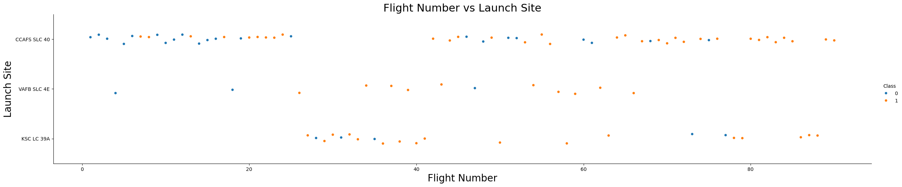
Flight Number vs. Launch Site
The graph shows that CCAFS SLC 40 is the most used launch site, with a trend toward greater diversification and flight success as flight numbers increase.

Slide 19
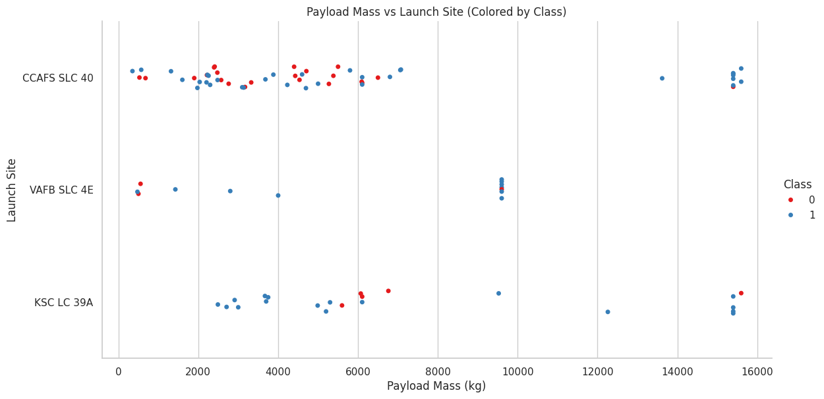
Payload vs. Launch Site
The graph shows that VAFB SLC 4E is not used for heavy payload launches, suggesting that this site is optimized for specific missions with lighter payloads. On the other hand, CCAFS SLC 40 and KSC LC 39A are the primary sites for heavy payload launches, with a high success rate.

Slide 20
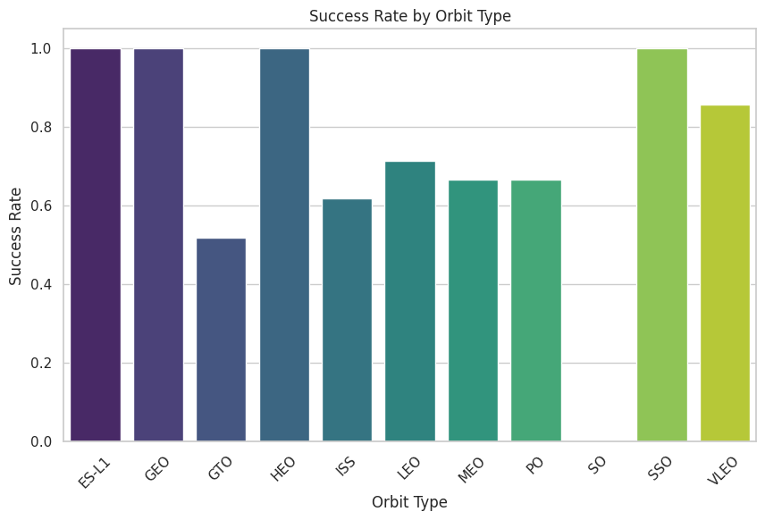
Success Rate vs. Orbit Type
The orbits with the highest success rates are those with 100% success: ES-L1, GEO, HEO, and SSO. Furthermore, VLEO has a very high success rate (85.7%), making it a very reliable orbit. On the other hand, GTO has a moderate success rate (51.9%), and SO has not had any successful launches in the analyzed data. This suggests that more specialized or less common orbits (such as SO) may be more challenging, while more common or better-optimized orbits (such as LEO and VLEO) have higher success rates.

Slide 21
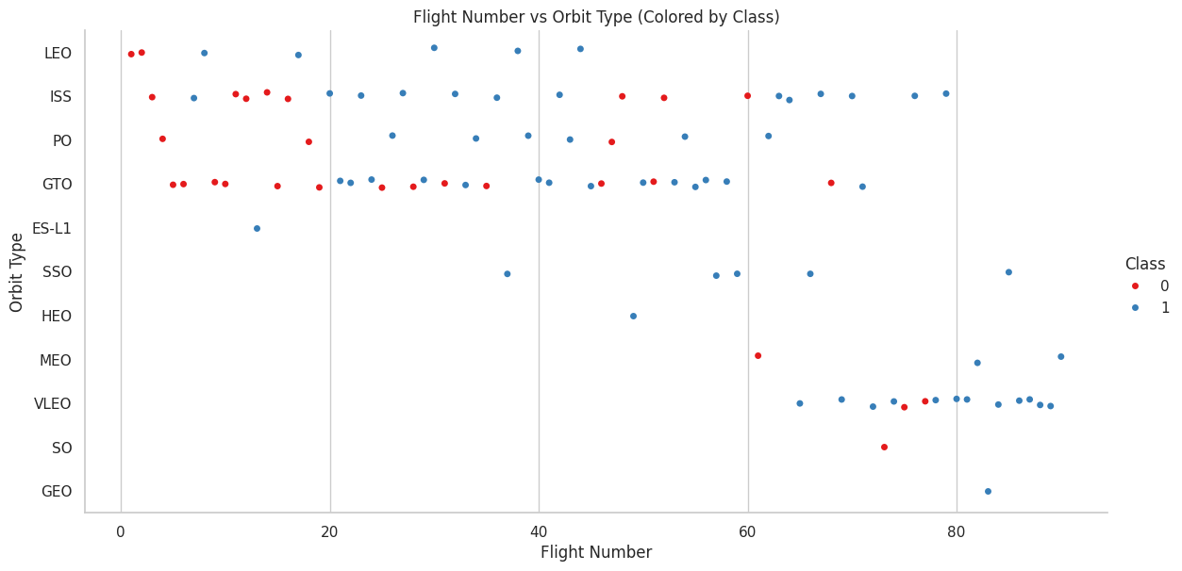
Flight Number vs. Orbit Type
In LEO orbit, success is correlated with flight number, suggesting that experience and technical improvements have increased the success rate over time.
In GTO orbit, there is no relationship between flight number and success, indicating that the technical complexity of these launches remains a challenge.
For other orbits, such as VLEO, a similar trend is observed, while in orbits such as PO and SSO, success does not appear to be related to flight number.
This analysis highlights the importance of considering both accumulated experience and technical complexity when evaluating success rates in different orbits.

Slide 22
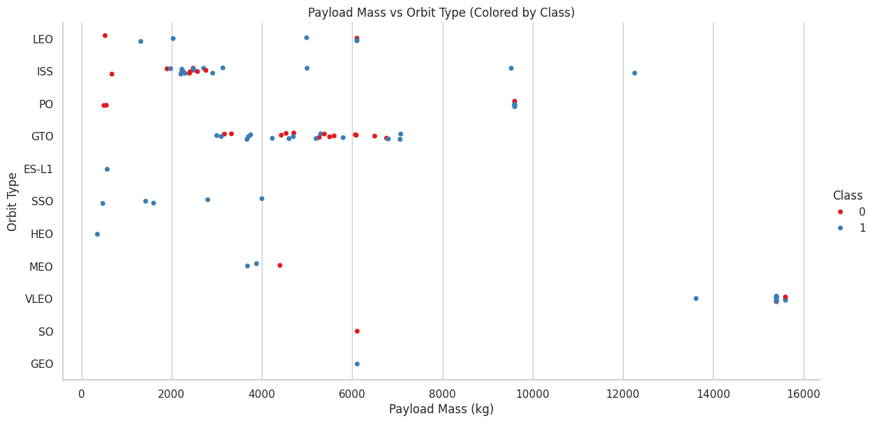
Payload vs. Orbit Type
For orbits such as LEO, ISS, and PO, launches with heavier payloads have higher success rates, suggesting that these orbits are well optimized for handling heavy payloads.
For the GTO orbit, there is no clear relationship between payload mass and success, indicating that other factors (such as technical complexity) play a more important role in launch outcome.
In general, the most common and best-optimized orbits tend to have higher success rates with heavy payloads, while more specialized or complex orbits (such as GTO) show a mix of successes and failures regardless of payload mass.

Slide 23
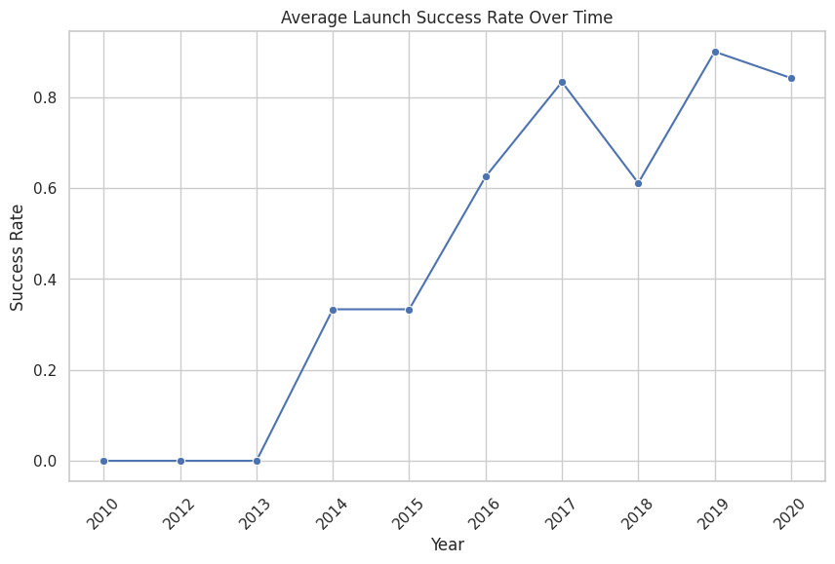
Launch Success Yearly Trend
The line graph shows that the average launch success rate has increased steadily from 2013 to 2020. This reflects continuous improvements in rocket technology, launch procedures, and accumulated experience. 2020 marks the peak of the success rate, underscoring the maturity and efficiency of launch systems during that period.

Slide 24
All Launch Site Names
SQL QUERY SELECT DISTINCT "LAUNCH_SITE" AS "Launch Sites" FROM SPACEXTBL;
PYTHON - PANDAS df['LaunchSite'].unique()
Identified launch sites:
CCAFS SLC 40: Launch site at Kennedy Space Center, Florida.
VAFB SLC 4E: Launch site at Vandenberg Space Force Base, California.
KSC LC 39A: Launch site at Launch Complex 39A at Kennedy Space Center, Florida.

Slide 25
Launch Site Names Begin with 'CCA'
SELECT * FROM SPACEXTABLE
WHERE Launch_Site LIKE 'CCA%’
LIMIT 5;
Date | Time (UTC) | Booster_Version | Launch_Site | Payload | PAYLOAD_MASS__KG_ | Orbit | Customer | Mission_Outcome | Landing_Outcome
2010-06-04 | 18:45:00 | F9 v1.0 B0003 | CCAFS LC-40 | Dragon Spacecraft Qualification Unit | 0 | LEO | SpaceX | Success | Failure (parachute)
2010-12-08 | 15:43:00 | F9 v1.0 B0004 | CCAFS LC-40 | Dragon demo flight C1, two CubeSats, barrel of Brouere cheese | 0 | LEO (ISS) | NASA (COTS) NRO | Success | Failure (parachute)
2012-05-22 | 7:44:00 | F9 v1.0 B0005 | CCAFS LC-40 | Dragon demo flight C2 | 525 | LEO (ISS) | NASA (COTS) | Success | No attempt
2012-10-08 | 0:35:00 | F9 v1.0 B0006 | CCAFS LC-40 | SpaceX CRS-1 | 500 | LEO (ISS) | NASA (CRS) | Success | No attempt
2013-03-01 | 15:10:00 | F9 v1.0 B0007 | CCAFS LC-40 | SpaceX CRS-2 | 677 | LEO (ISS) | NASA (CRS) | Success | No attempt

Slide 26
Total Payload Mass
SELECT SUM(PAYLOAD_MASS__KG_) AS TOTAL_PAYLOAD_MASS
FROM SPACEXTABLE
WHERE CUSTOMER = 'NASA (CRS)';
TOTAL_PAYLOAD_MASS
45596
The query will return the total payload mass (in kilograms) carried by boosters launched for NASA (CRS). It means that boosters for NASA (CRS) have carried a cumulative payload mass of 45,596 kg.

Slide 27
Average Payload Mass by F9 v1.1
SELECT AVG(PAYLOAD_MASS__KG_) AS AVG_PAYLOAD_MASS
FROM SPACEXTABLE
WHERE BOOSTER_VERSION LIKE '%F9 v1.1%';
AVG_PAYLOAD_MASS
2534.6666666666665
The query will return the average payload mass (in kilograms) carried by the F9 v1.1 booster. It means that the F9 v1.1 booster has carried an average payload mass of 2,534.7 kg.

Slide 28
First Successful Ground Landing Date
SELECT MIN(Date) AS FIRST_SUCCESSFUL_GROUND_LANDING
FROM SPACEXTABLE
WHERE Landing_Outcome = 'Success (ground pad)';
FIRST_SUCCESSFUL_GROUND_LANDING
2015-12-22
The query will return the date of the first successful landing on a ground pad. It means that the first successful ground pad landing occurred on December 22, 2015. This query identifies the historic moment when SpaceX achieved its first successful landing of a Falcon 9 booster on a ground pad. This milestone marked a significant step in SpaceX's efforts to develop reusable rocket technology, reducing the cost of spaceflight and paving the way for more sustainable exploration.

Slide 29
Successful Drone Ship Landing with Payload between 4000 and 6000
SELECT DISTINCT BOOSTER_VERSION
FROM SPACEXTABLE
WHERE Landing_Outcome = 'Success (drone ship)’
AND PAYLOAD_MASS__KG_ > 4000
AND PAYLOAD_MASS__KG_ < 6000;
Booster_Version
F9 FT B1022
F9 FT B1026
F9 FT B1021.2
F9 FT B1031.2
The query will return a list of booster versions that meet the specified criteria.
This query identifies reusable boosters that successfully landed on drone ships while carrying payloads in the mid-range mass category (4000–6000 kg).

Slide 30
Total Number of Successful and Failure Mission Outcomes
SELECT
CASE
WHEN MISSION_OUTCOME LIKE 'Success%' THEN 'Success'
ELSE MISSION_OUTCOME
END AS MISSION_OUTCOME,
COUNT(*) AS TOTAL
FROM SPACEXTABLE
GROUP BY
CASE
WHEN MISSION_OUTCOME LIKE 'Success%' THEN 'Success'
ELSE MISSION_OUTCOME
END;
MISSION_OUTCOME | TOTAL
Failure (in flight) | 1
Success | 100
This query provides a high-level overview of the mission outcomes in the dataset, helping to understand the reliability and performance of the launch vehicles. The results align with SpaceX's overall success rate, which is consistently high, especially for the Falcon 9.

Slide 31
Boosters Carried Maximum Payload
SELECT BOOSTER_VERSION, PAYLOAD_MASS__KG_
FROM SPACEXTABLE
WHERE PAYLOAD_MASS__KG_ =
(SELECT MAX(PAYLOAD_MASS__KG_)
FROM SPACEXTABLE);
Booster_Version | PAYLOAD_MASS__KG_
F9 B5 B1048.4 | 15600
F9 B5 B1049.4 | 15600
F9 B5 B1051.3 | 15600
F9 B5 B1056.4 | 15600
F9 B5 B1048.5 | 15600
F9 B5 B1051.4 | 15600
F9 B5 B1049.5 | 15600
F9 B5 B1060.2 | 15600
F9 B5 B1058.3 | 15600
F9 B5 B1051.6 | 15600
F9 B5 B1060.3 | 15600
F9 B5 B1049.7 | 15600
This query is useful for identifying booster versions that have been used on missions with the highest payload mass. This can provide information on the payload capacity of different booster versions and their importance in missions requiring heavy payloads.

Slide 32
2015 Launch Records
%sql SELECT substr(Date, 6, 2) as month,
Landing_Outcome,
BOOSTER_VERSION,
LAUNCH_SITE
FROM SPACEXTABLE
WHERE substr(Date, 0, 5) = '2015' AND "Landing_Outcome" LIKE 'Failure (drone ship)';
month | Landing_Outcome | Booster_Version | Launch_Site
01 | Failure (drone ship) | F9 v1.1 B1012 | CCAFS LC-40
04 | Failure (drone ship) | F9 v1.1 B1015 | CCAFS LC-40
This query is useful for analyzing failed drone ship landing attempts during 2015. It provides information on the months in which these failures occurred, the booster versions involved, and the launch sites from which the launches were conducted. This can help identify patterns or areas for improvement in SpaceX's recovery operations.

Slide 33
Rank Landing Outcomes Between 2010-06-04 and 2017-03-20
Landing_Outcome | Landing_Count
No attempt | 10
Success (drone ship) | 5
Failure (drone ship) | 5
Success (ground pad) | 3
Controlled (ocean) | 3
Uncontrolled (ocean) | 2
Failure (parachute) | 2
Precluded (drone ship) | 1
SELECT Landing_Outcome,
COUNT(*) AS Landing_Count
FROM SPACEXTABLE
WHERE Date BETWEEN '2010-06-04’
AND '2017-03-20'
GROUP BY Landing_Outcome
ORDER BY Landing_Count DESC;
This query is useful for analyzing the distribution of SpaceX landing results within a specific period. The results show how many times each landing type occurred, which can help identify patterns, areas for improvement, and the effectiveness of SpaceX's recovery strategies during that period.

Slide 34

Section 3

Slide 35
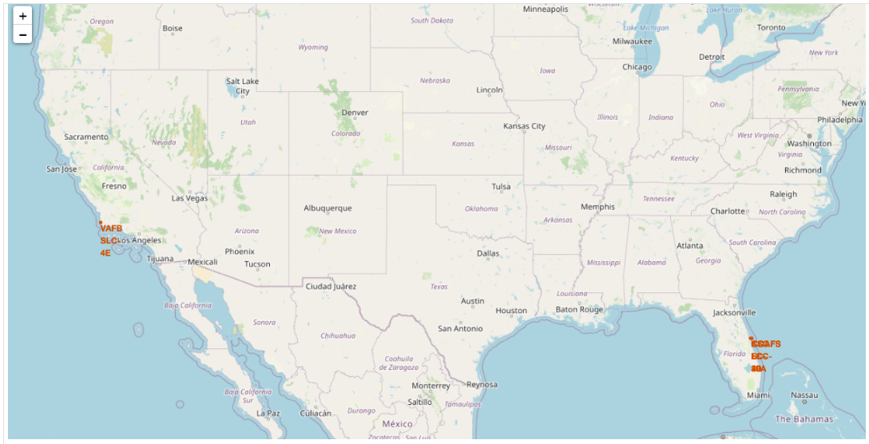
Global Launch Site Locations
Key Findings:
Sites concentrated in the US: East Coast (Florida) and West Coast (California)
Strategic locations near coasts for safe trajectories
Non-equatorial distribution, balancing geographic and logistical advantages

Slide 36
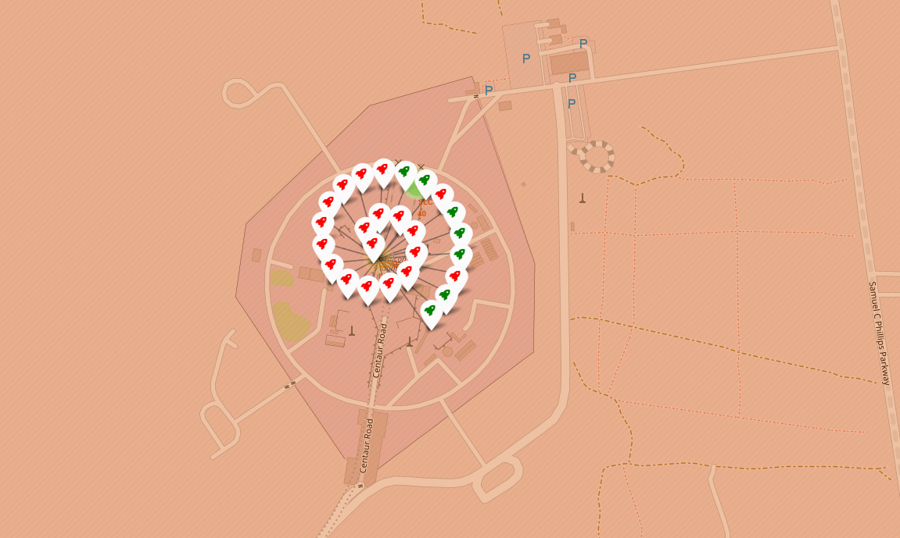
Analysis of Successes and Failures by Site
Important Observations:
A predominance of green markers indicates a high overall success rate.
Denser clusters at sites with higher launch frequency.
Possible correlation between location and success rate.

Slide 37
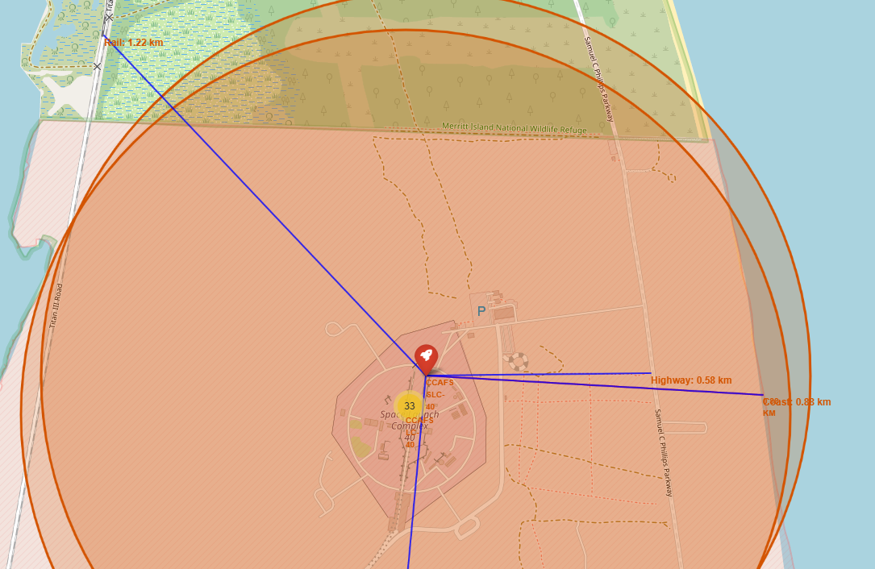
Proximity to Key Infrastructure
Proximity Analysis for CCAFS SLC-40 :
Distance to the coast: approximately 0.88 km
Proximity to rail: approximately 1.22 km
Proximity to highway: approximately 0.58 km
Proximity to city: approximately 17.63 km
Conclusions:
Strategically located sites near coasts for safety
Good connection to transportation infrastructure
Prudent distance from urban areas for safety

Slide 38

Section 4

Slide 39
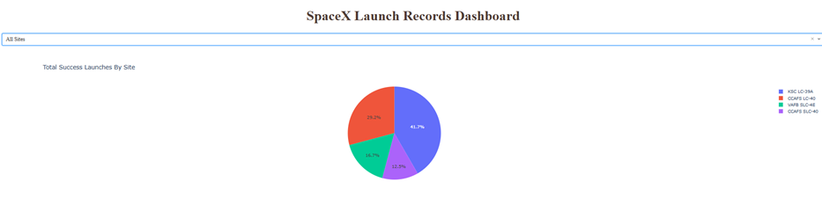
Launch Success by Site
Distribution of Launch Success by Site
Important elements and findings:
The chart shows the proportion of successful launches for each site.
It allows you to quickly identify which site has the highest number of successful launches.
It facilitates visual comparison between different launch sites.

Slide 40
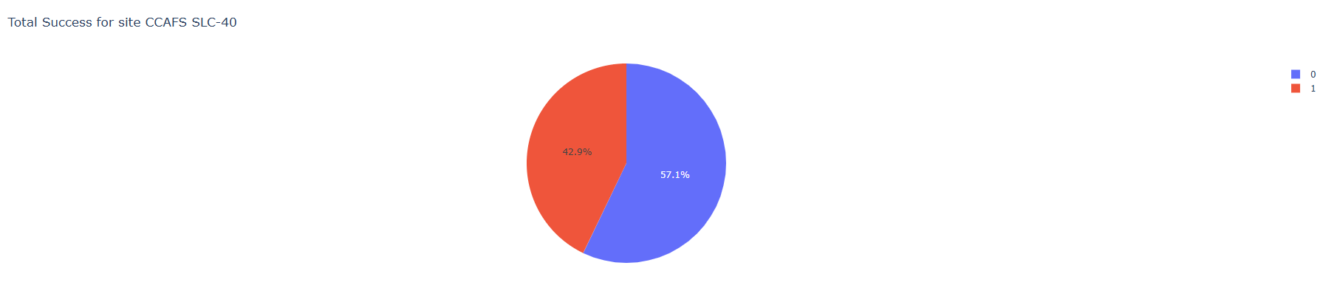
Site with Highest Success Rate
Detailed Analysis of the Site with the Highest Success Rate
Key Elements and Findings:
Shows the ratio of successful vs. failed launches for the selected site.
Allows for a deeper analysis of the success rate of the most effective site.
Provides context on the reliability of the most successful launch site.

Slide 41
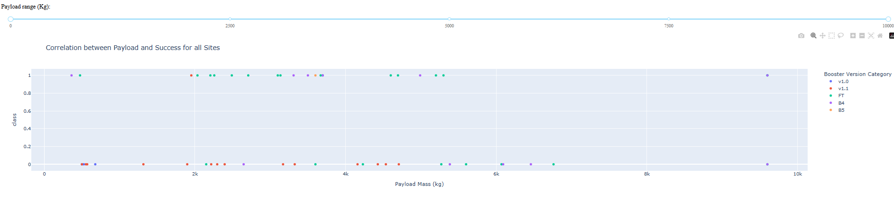
Relationship between payload and launch success
Impact of payload on launch success
Important elements and findings:
Visualizes the relationship between payload mass and launch success.
Dots are colored by booster version, allowing additional patterns to be identified.
Key observations:
Payload ranges with the highest success rate. Between 2000 kg and 4000 kg
Booster versions with the best performance. The best is FT
Potential correlations between payload mass and mission success.

Slide 42

Section 5

Slide 43
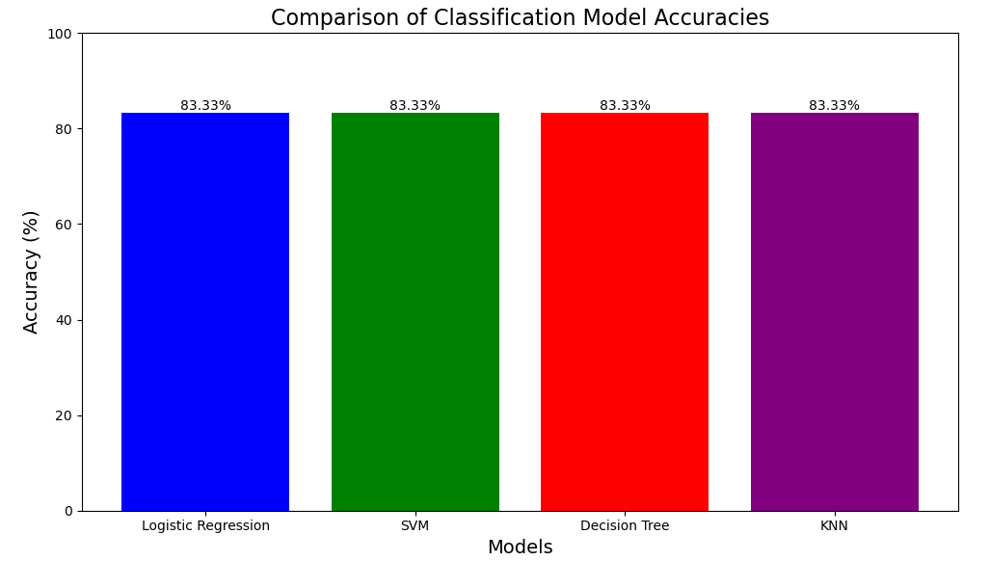
Classification Accuracy
All models performed similarly, but logistic regression was selected for simplicity.

Slide 44

Confusion Matrix
True Positives (12): Successful landings correctly predicted.
False Positives (3): Incorrect predictions as successful landinds.
Explination: The model is able to distinguish classes, but has room for improvement in falses positives.

Slide 45
Conclusions
SpaceX as a leader in innovation: SpaceX has revolutionized the aerospace industry by significantly reducing costs through the reusability of the Falcon 9, setting a new standard for space launches.
Importance of prediction: The ability to predict the success of a Falcon 9 landing is crucial for assessing the economic viability of launches and for other companies to compete in the market.
Robust Predictive Models: The evaluated models (Logistic Regression, SVM, Decision Tree, KNN) showed consistent accuracy (~83%), indicating that the data is well-structured and suitable for predictive analysis.
Logistic Regression as the Preferred Model: Although all models had similar performance, logistic regression was selected for its simplicity and computational efficiency for this dataset.
Impact on the Space Industry: This predictive approach can be used by competing companies to optimize their strategies and reduce costs, fostering greater competitiveness in the aerospace sector.

Slide 46
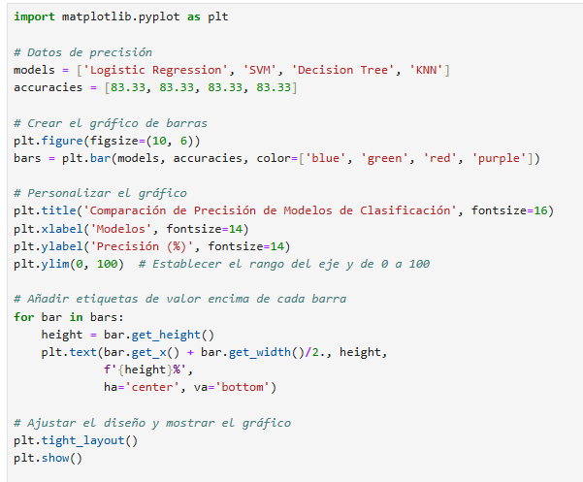
Appendix
Code for comparison of Classification Model Accuracies
Limitations and Future Opportunities:
Limitations: The false positives identified in the confusion matrix indicate areas where the models can be improved.
Opportunities: Incorporating more relevant features on weather conditions, rocket design, and historical data could improve predictions.
Applications Beyond SpaceX:This analysis can be adapted to other reusable space vehicles, helping to evaluate their performance and economic viability.
The Value of Machine Learning:This project demonstrates how machine learning algorithms can be applied to real-world problems to make data-driven decisions.

Slide 47


